Slide 2



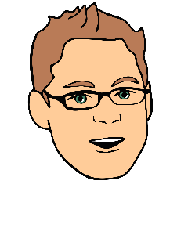

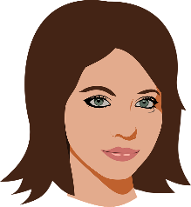


One Bridge - from Business to Technology
The only place you need to go for turning ideas or problems into future possibilities.
Idea / Problem Home

